Slide 1
AZURE BLOB & ADLS
HOW TO CREATE

Slide 2
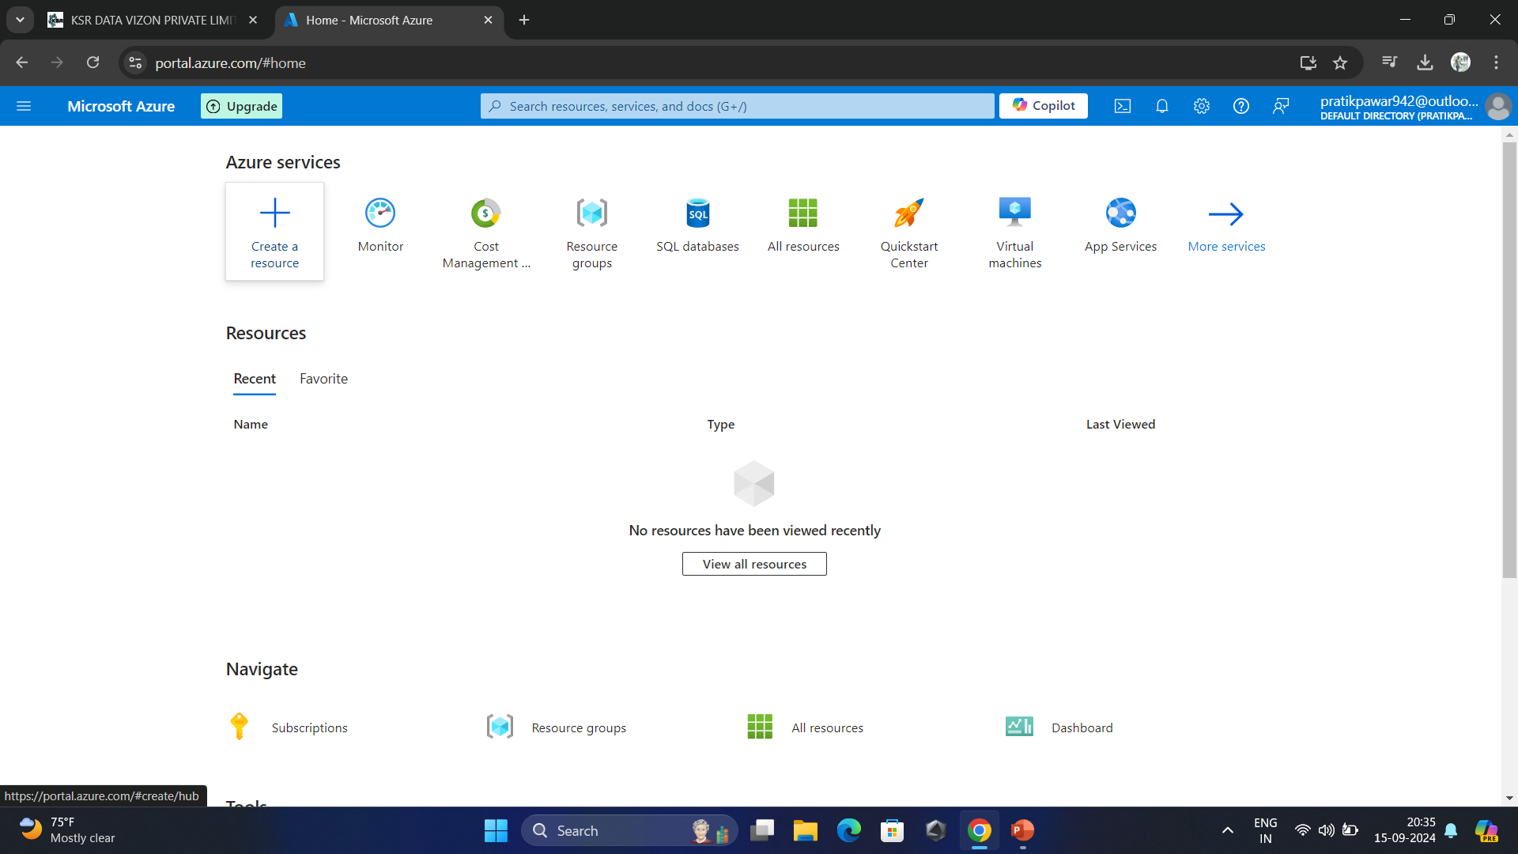
Create a Resource

Slide 3
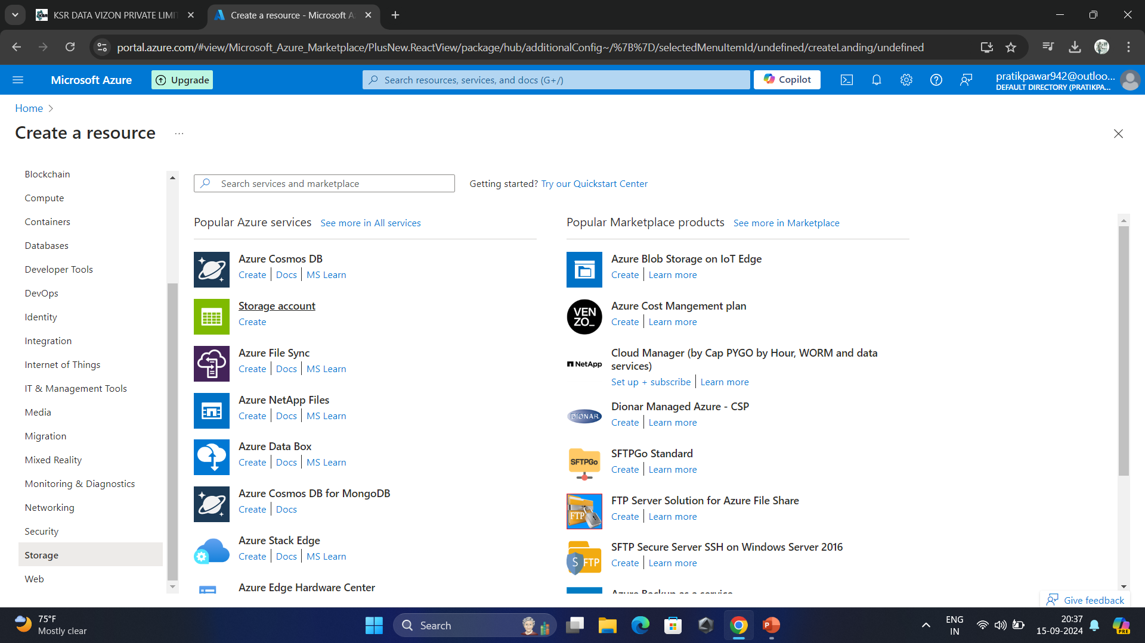

Slide 4
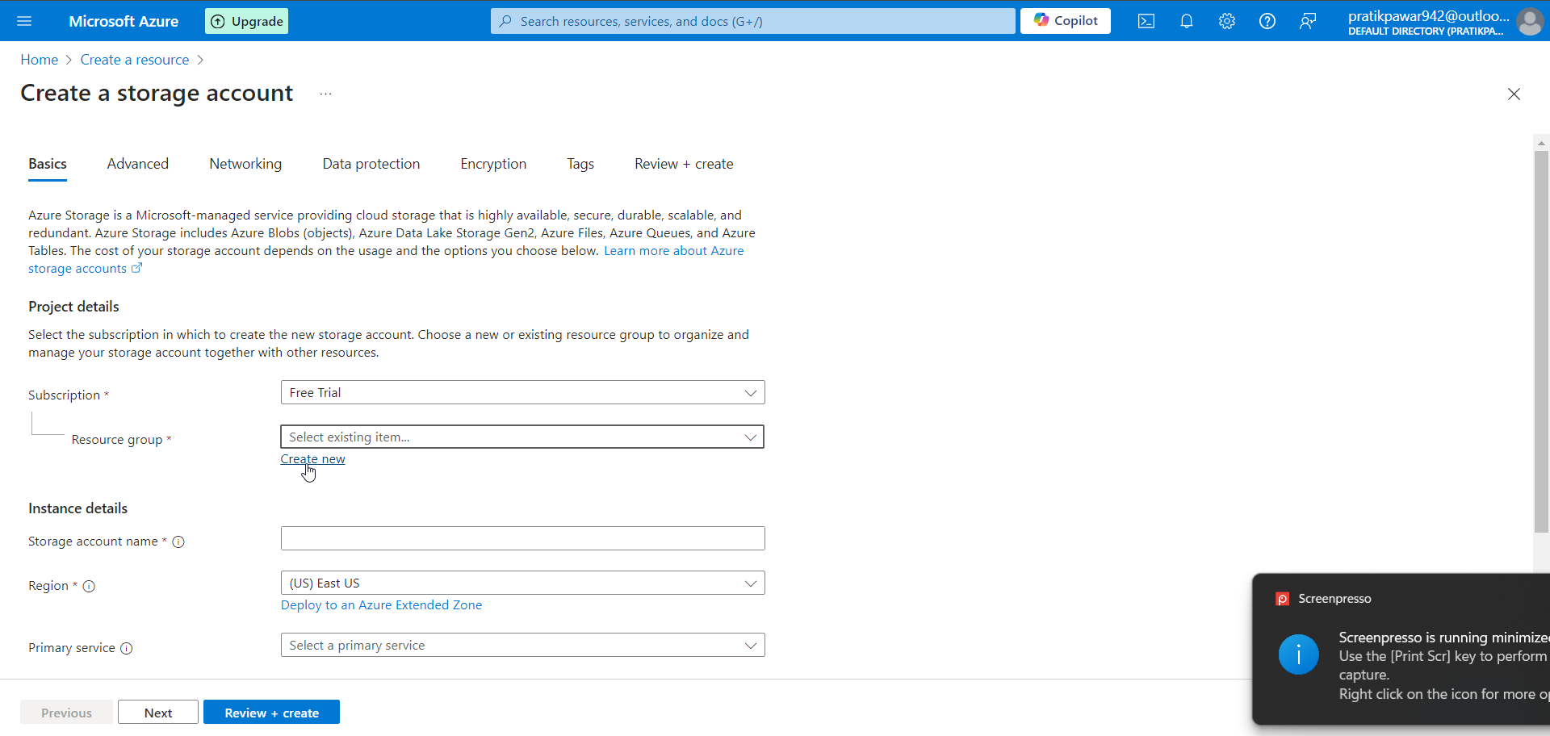
Create New Resourse Group

Slide 5
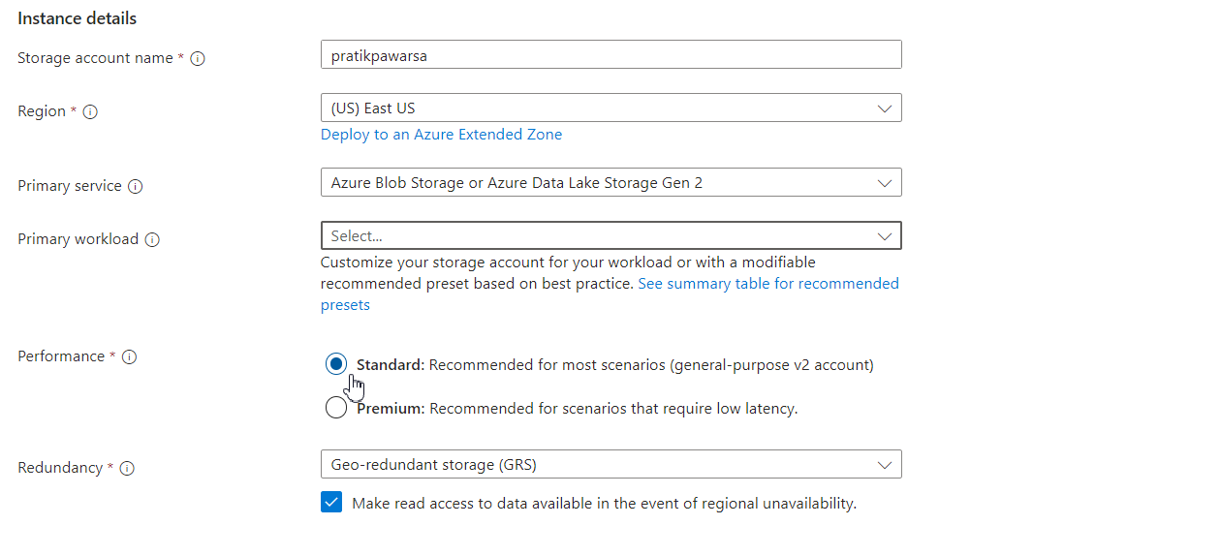
Standard or Premium (According to Need)

Slide 6
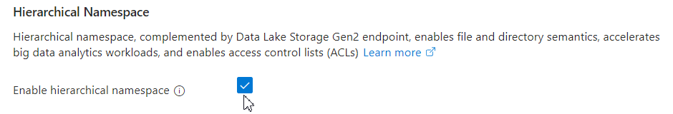
Creates ADLS (Azure Data Lake Storage)

Slide 7
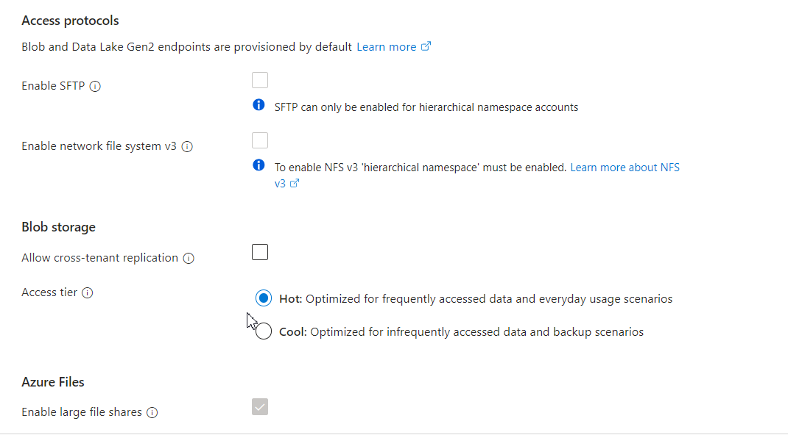
Cool or Hot (According to Need)

Slide 8
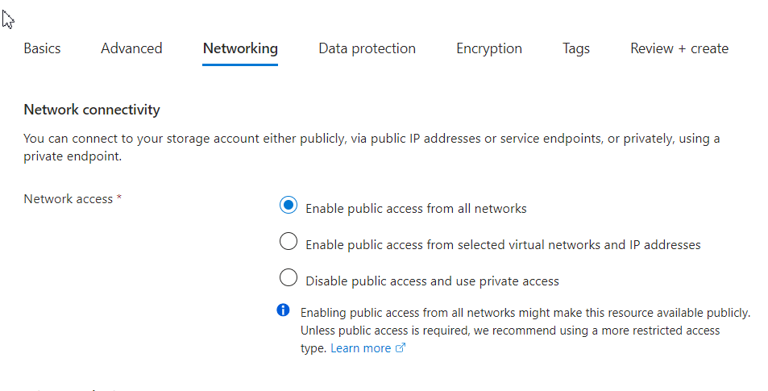
Public Access

Slide 9
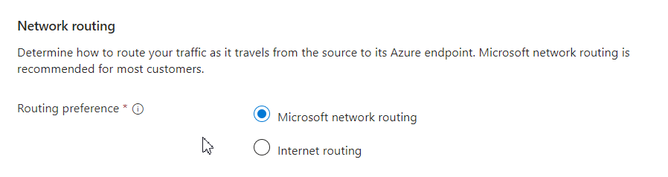
Prefer Microsoft Network Routing

Slide 10
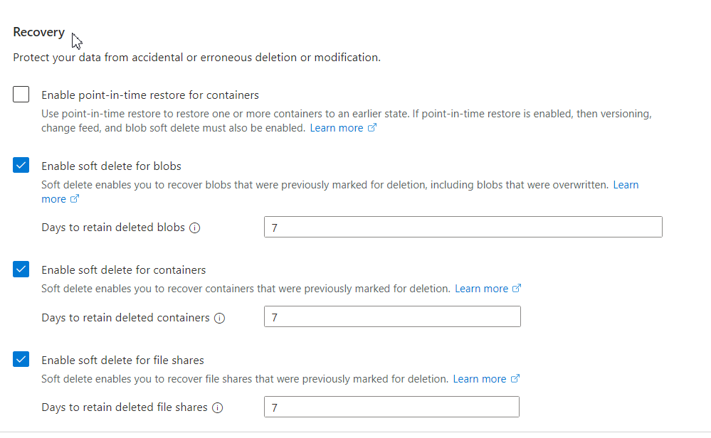
Recovery

Slide 11
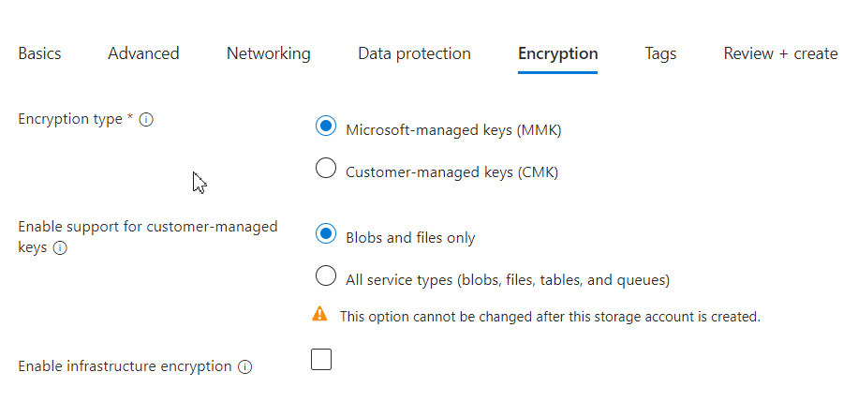
Encryption
Just Review and Create Account Now

